Slide 1
Part C.
Choosing Closed-loop Pole Locations
The methods discussed in the previous sections can be used to calculate a feedback vector which will place the poles of the closed-loop system in desired locations. The next question is “where should the closed-loop poles be located?” There are several ways to answer:
Dominant Second-Order System Response
Dead Beat Response
Prototype System Response

Slide 2
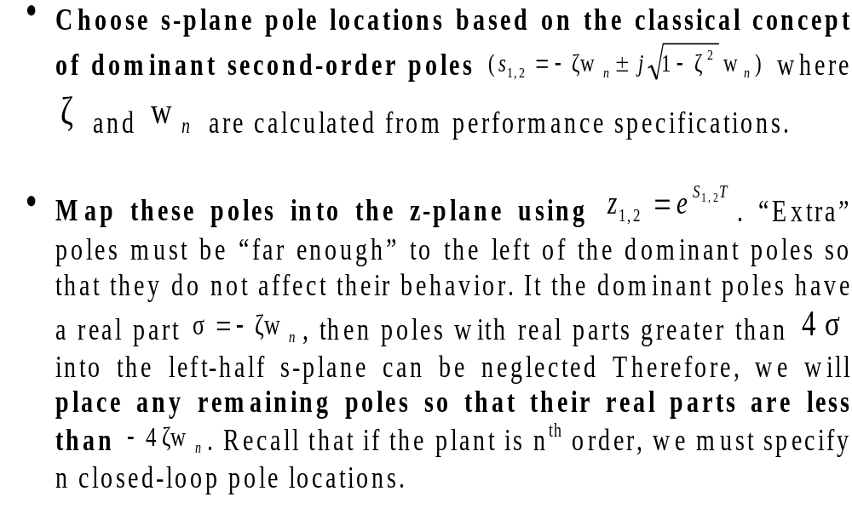
Specifying Dominant Poles

Slide 3
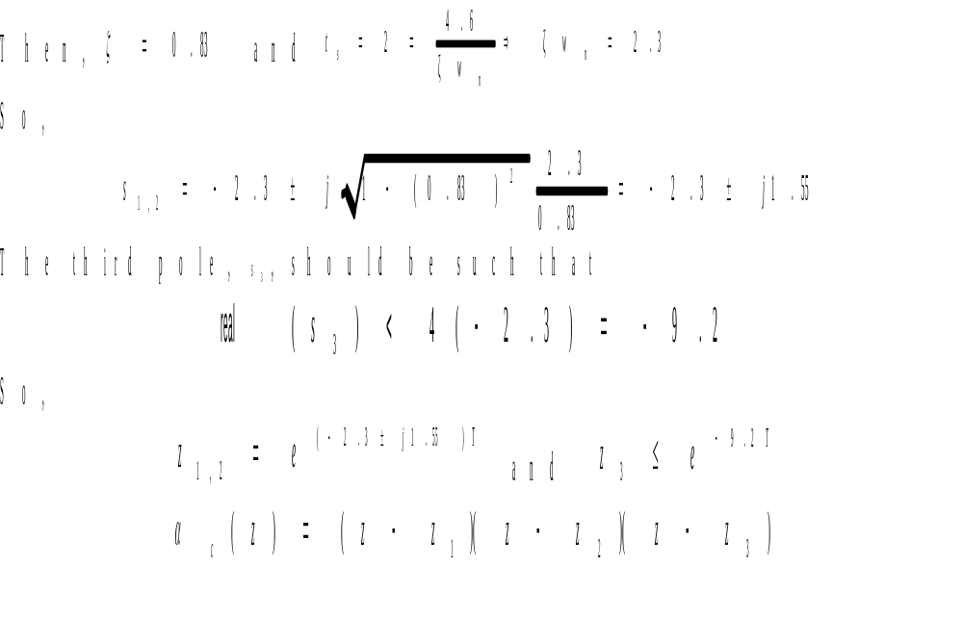
Example
Suppose we have a third–order system and a step response of 1% overshoot and a settling time of 2 seconds are specified.

Slide 4
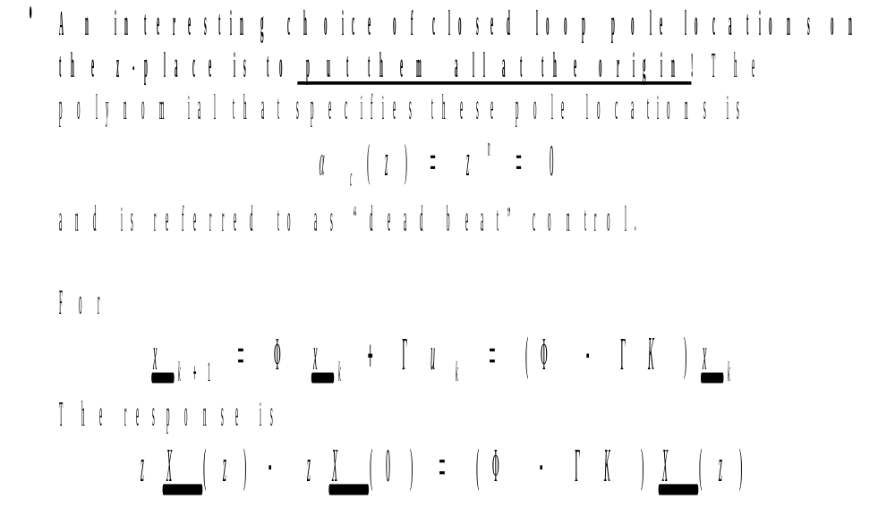
Dead Beat Control

Slide 5
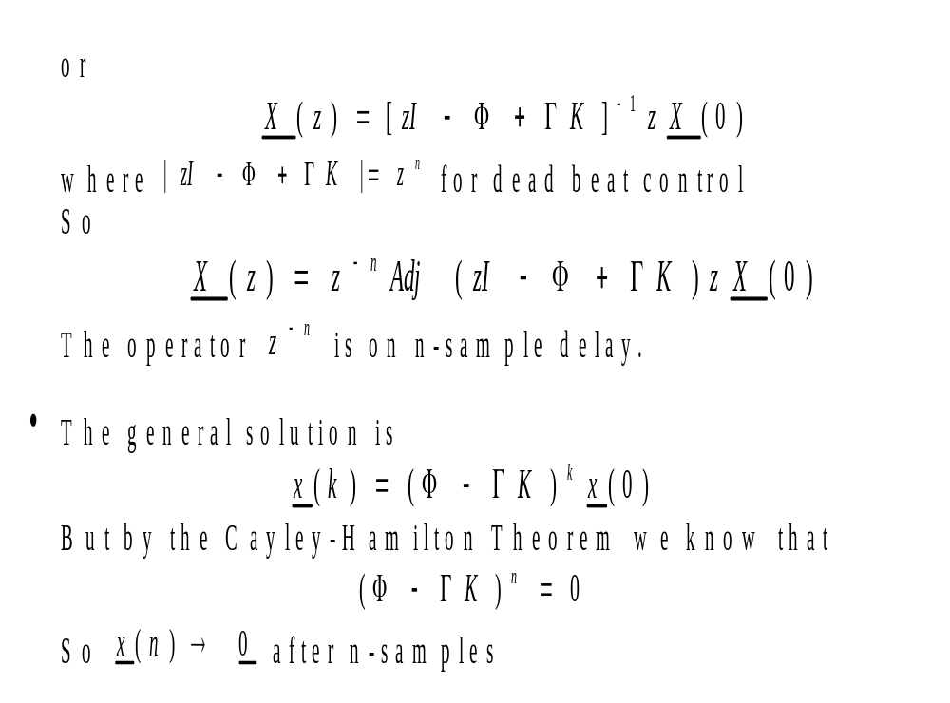
Dead Beat Control (Cont’d)

Slide 6
Dead Beat Control (Cont’d)
From the concept of controllability we know that it is possible to find an input that will drive a controllable system to a desired state in n-steps, where n is the order of the system. Deadbeat regulation will take nT seconds, assuming that the behavior of the system between samples is not oscillatory.).Because n is fixed the only way to limit the D/A output is to Small T, therefore implies a small settling time, except it may not be achievable due to the large control magnitudes required (D/A converters have limited outputs increase T.
In some cases this is no problem; but, if there are disturbances to the plant, too large a value of T results in poor disturbance rejection.

Slide 7
Dead beat Control (Cont’d)
Thus, deadbeat control should only be used when:
The plant model is highly accurate
Plant disturbances are negligible
The plant can handle large input discontinuities

Slide 8
Prototype Systems
Another way to choose closed-loop pole locations is to consider the step responses to various prototype systems. Two popular prototypes are ITAE (Integral of Time times the Absolute Error) and Bessel. Subsequent slides present the step and frequency responses of each of these from the Franklin, Powell and Emani-Naeini text. The ITAE features a quick step response with slight overshoot and Bessel features a maximally- flat, but lower bandwidth, frequency response. Their poles locations, normalized to one rad/sec, are given in tabular form.

Slide 9
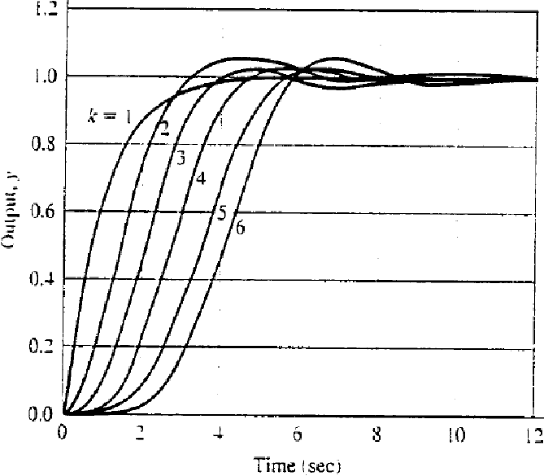
Step Response of ITAE Prototypes for w₀=1 rad/sec

Slide 10
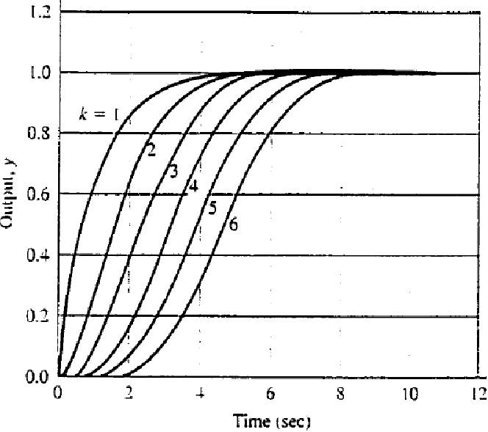
Step Response of Bessel Prototypes Systems for w₀=1 rad/sec

Slide 11
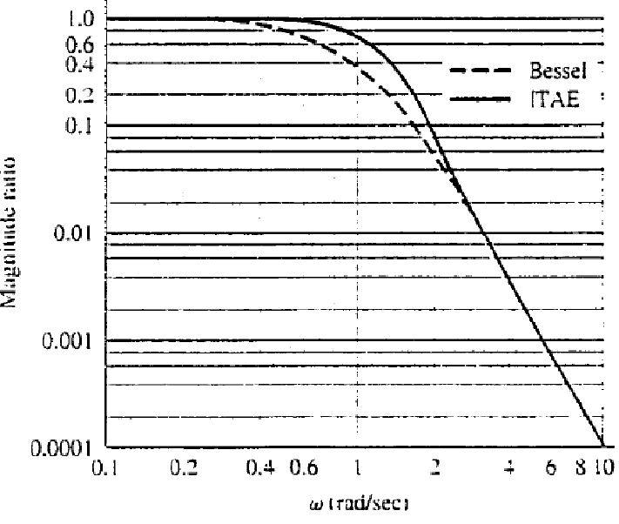
Frequency-response magnitude of ITAE and Bessel Prototype Systems for k=4

Slide 12
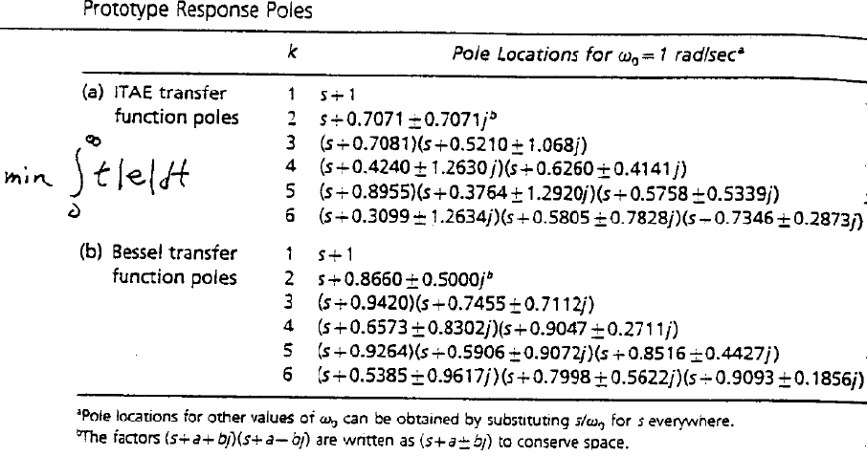
Prototype Response Poles

Slide 13
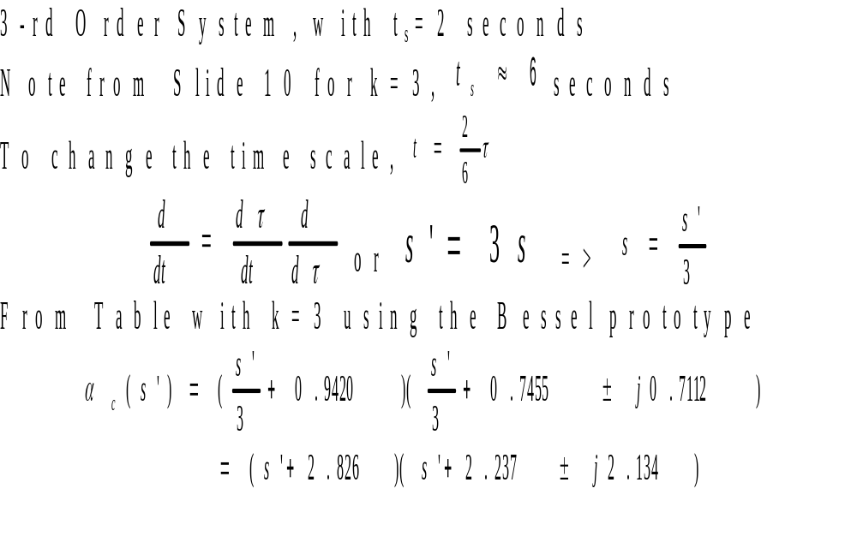
Example

Slide 14
Examples: Closed-Loop Pole Placement
PROGRAM STVFBEX
This program computes the state-variable feedback gain matrix, K, given the coefficient matrix, A, and driving matrix, B, of the plant; the sample period, ts; and the desired closed-loop poles in the s-plane, s(i) for i equal 1 to n, where n is the order of the system.
It also plots the resulting state variables and control action, u, versus time, given an initial condition, x0,and time duration, tf.

Slide 15
Examples: Closed-Loop Pole Placement (Cont’d)
% Input Parameters
A=input('A= '); % Coefficient Matrix
B=input('B= '); [n,c]=size(B); % Driving Matrix and Order of System
ts=input('ts= '); % Sample Period
x0=input('x0= '); % Initial State Vector
tf=input('tf= '); % Final Time
for i=1:n
s(i)=input('s(i)= '); % Desired Closed-Loop Poles
end
% Form Vector of Desired Closed-Loop Poles in z-plane
for i=1:n
z(i)=exp(s(i)*ts);
end
clp=z'; clp

Slide 16
Examples: Closed-Loop Pole Placement (Cont’d)
% Compute Discrete State Space Model, phi and gamma
[phi,gamma]=c2d(A,B,ts); phi, gamma
% Compute Feedback Gains
k=place(phi,gamma,clp);k
% Compute Closed-Loop Coefficient Matrix
phicl=phi-gamma*k;
% Compute State Trajectory and Control Sequence
N=round(tf/ts)+1;
[y,x]=dinitial(phicl,zeros(n,1),eye(n),zeros(n,1),x0,N);
u=-k*x';
t=0:ts:(N-1)*ts;
% Plot State Trajectories and Control Sequence
figure(1),clf,subplot(211),plot(t,x),title('STATE TRAJECTORIES'),xlabel('TIME'),grid
subplot(212),stairs(t,u),title('CONTROL SEQUENCE'),xlabel('TIME'),grid

Slide 17
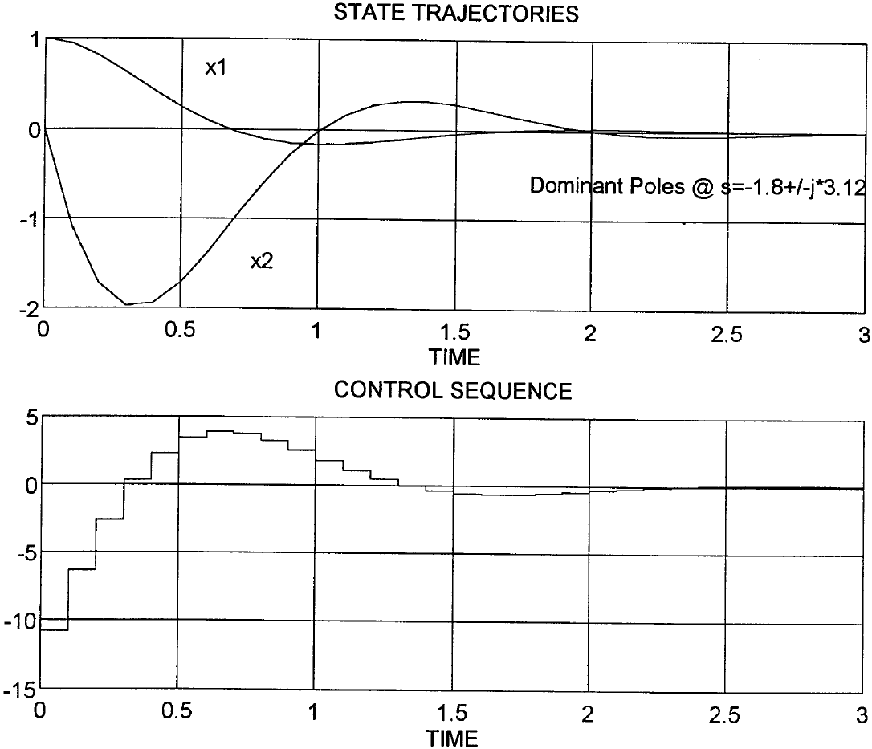
Dominant Pole Location
A= [0,1;0,0]
B= [0,1]'
ts= 0.1
x0= [1,0]'
tf= 3.0
s(i)= -1.8+j*3.12
s(i)= conj(s(1))
clp =
0.7949 - 0.2564i
0.7949 + 0.2564i
phi =
1.0000 0.1000
0 1.0000
gamma =
0.0050
0.1000
place: ndigits= 15
k =
10.7787 3.5622

Slide 18
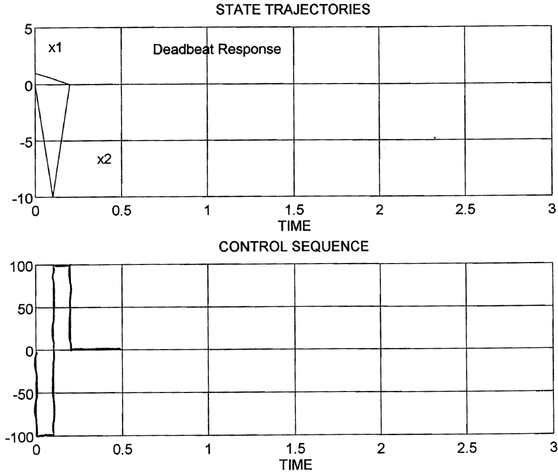
Deadbeat Response
A= [0,1;0,0]
B= [0,1]'
ts= 0.1
x0= [1,0]'
tf= 3.0
s(i)= -180
s(i)= -181
clp =
1.0e-007 *
0.1523
0.1378
phi =
1.0000 0.1000
0 1.0000
gamma =
0.0050
0.1000
place: ndigits= 15
Warning: Pole locations are more than 10% in error.
k =
100.0000 15.0000

Slide 19
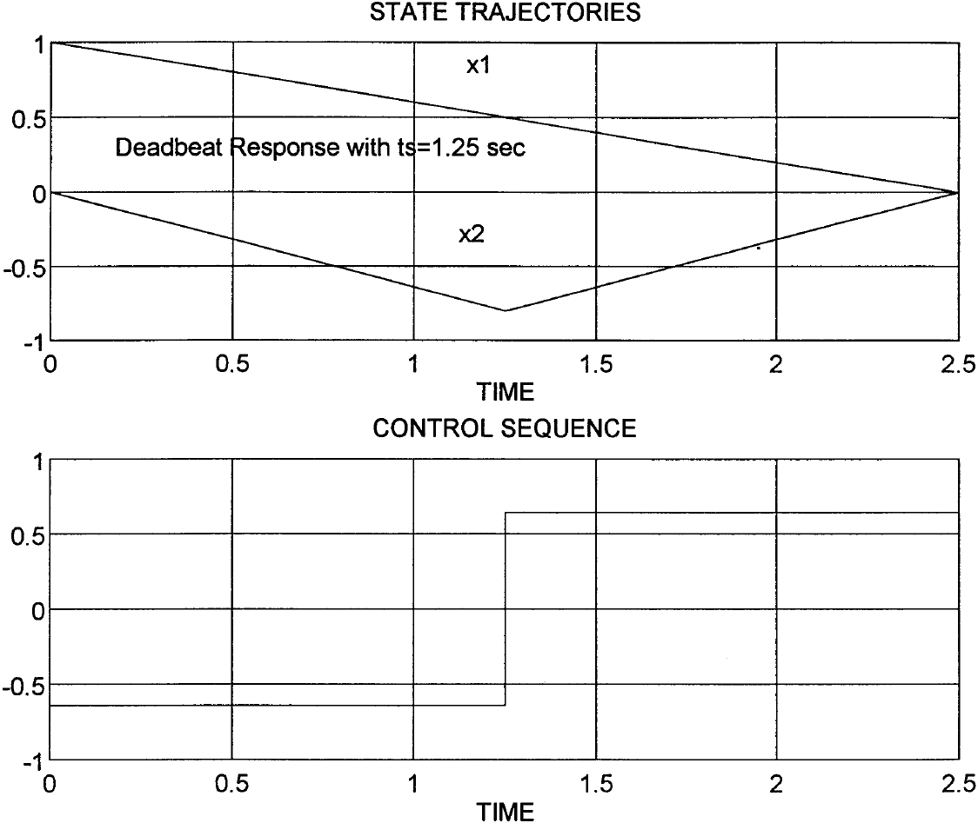
Deadbeat Response with ts=settling time/2
A= [0,1;0,0]
B= [0,1]'
ts= 1.25
x0= [1,0]'
tf= 3.0
s(i)= -18
s(i)= -19
clp =
1.0e-009 *
0.1692
0.0485
phi =
1.0000 1.2500
0 1.0000
gamma =
0.7813
1.2500
place: ndigits= 15
Warning: Pole locations are more than 10% in error.
k =
0.6400 1.2000

Slide 20
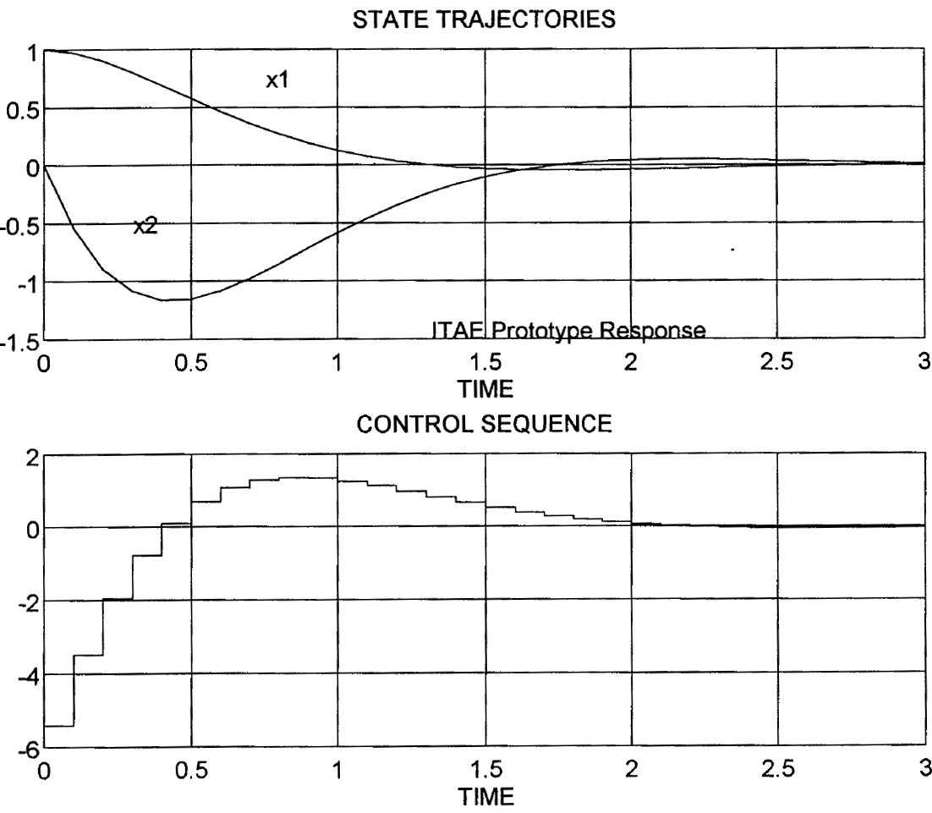
ITAE Prototype Pole Placement
A= [0,1;0,0]
B= [0,1]'
ts= 0.1
x0= [1,0]'
tf= 3.0
s(i)= -1.8+j*1.8
s(i)= conj(s(1))
clp =
0.8218 - 0.1495i
0.8218 + 0.1495i
phi =
1.0000 0.1000
0 1.0000
gamma =
0.0050
0.1000
place: ndigits= 15
k =
5.4126 3.2939

Slide 21
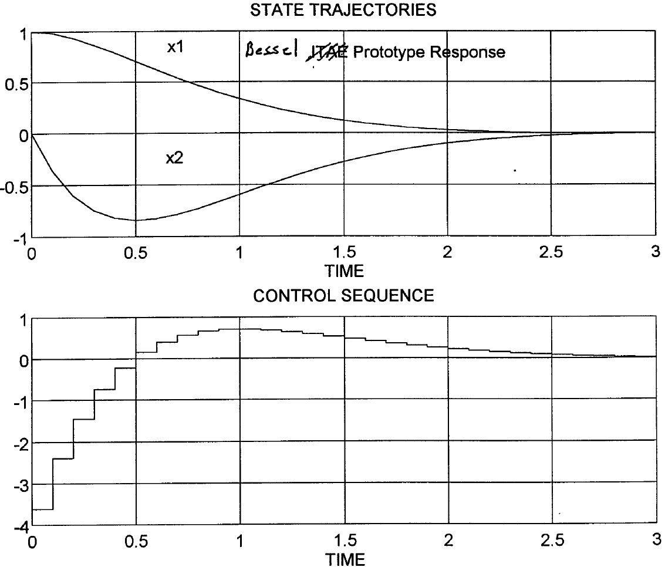
Bessel Prototype Pole Placement
A= [0,1;0,0]
B= [0,1]'
ts= 0.1
x0= [1,0]'
tf= 3.0
s(i)= -1.8+j*1.0393
s(i)= conj(s(1))
clp =
0.8308 - 0.0867i
0.8308 + 0.0867i
phi =
1.0000 0.1000
0 1.0000
gamma =
0.0050
0.1000
place: ndigits= 15
k =
3.6150 3.2040

